Slide 1


Uygulamalı Doğal Dil İşleme
Kemal Can Kara
GPT Architecture, Bert Applications
29 November 2024
1

Slide 2
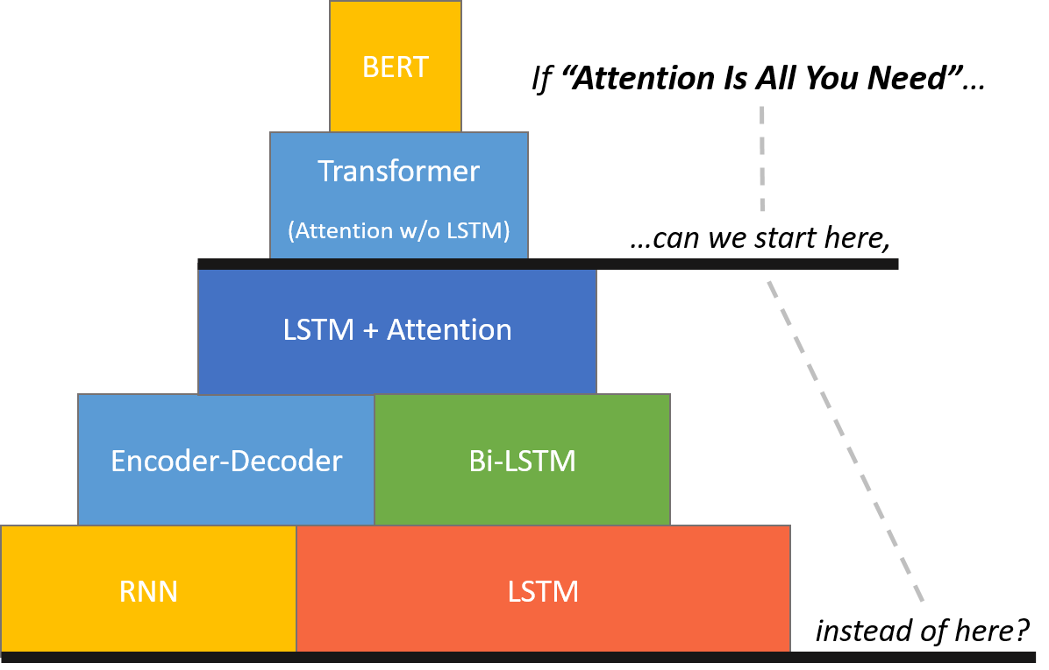
A Quick Recap
Slide credit: http://mccormickml.com/2019/11/11/bert-research-ep-1-key-concepts-and-sources/

Slide 3
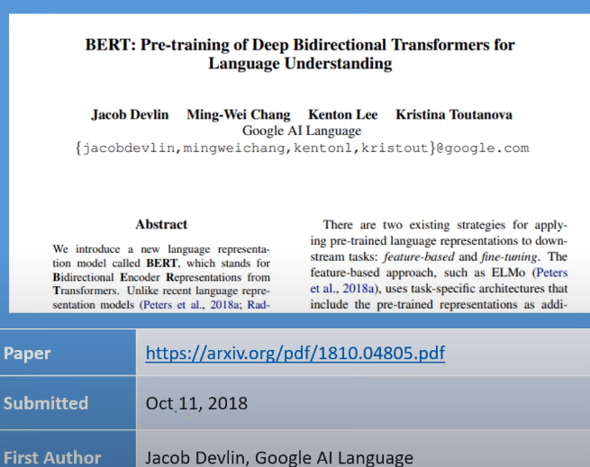
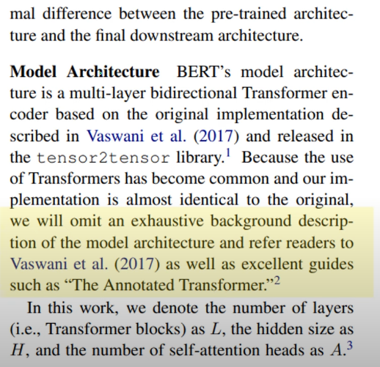
A Quick Recap
Slide credit: http://mccormickml.com/2019/11/11/bert-research-ep-1-key-concepts-and-sources/

Slide 4
A Quick Recap
BERT —— The Illustrated BERT, ELMo, and co. (How NLP Cracked Transfer Learning)
Published: Dec 3, 2018
Transformer —— The Illustrated Transformer
Published: Jun 27, 2018
Attention —— Visualizing A Neural Machine Translation Model (Mechanics of Seq2seq Models With Attention)
Published: May 9, 2018
Slide credit: http://mccormickml.com/2019/11/11/bert-research-ep-1-key-concepts-and-sources/

Slide 5
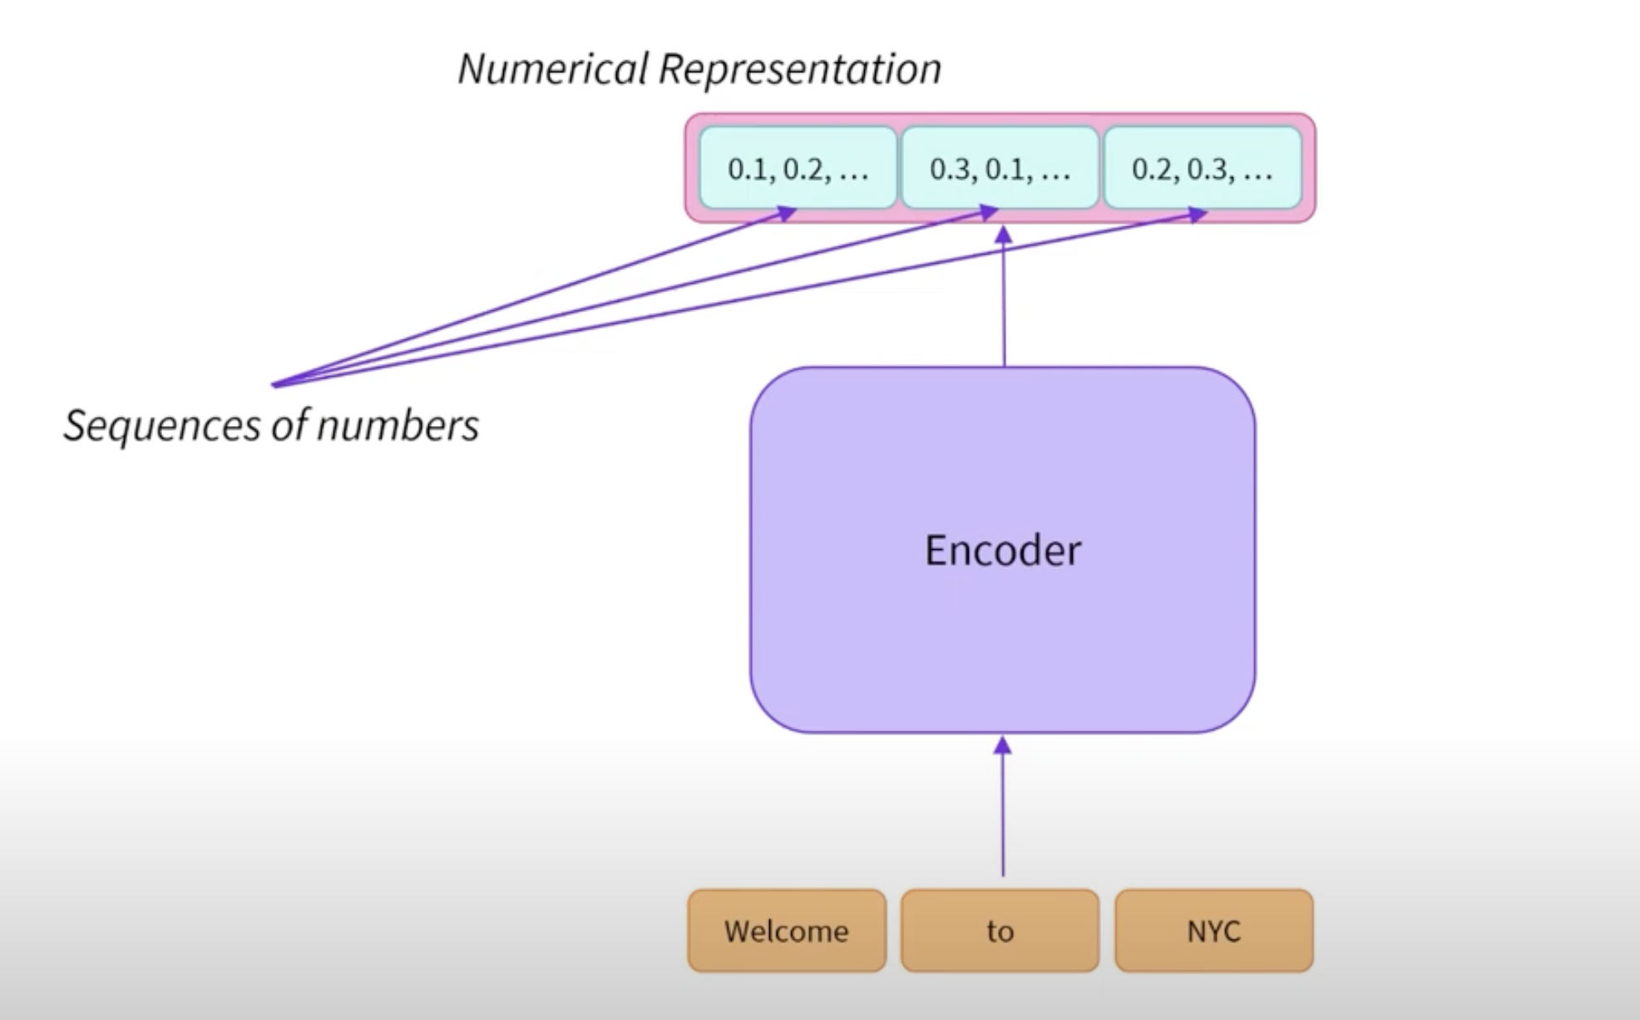
A Quick Recap
The encoder outputs a numerical representation for each word used as input
Slide credit: https://www.youtube.com/watch?v=MUqNwgPjJvQ&ab_channel=HuggingFace

Slide 6
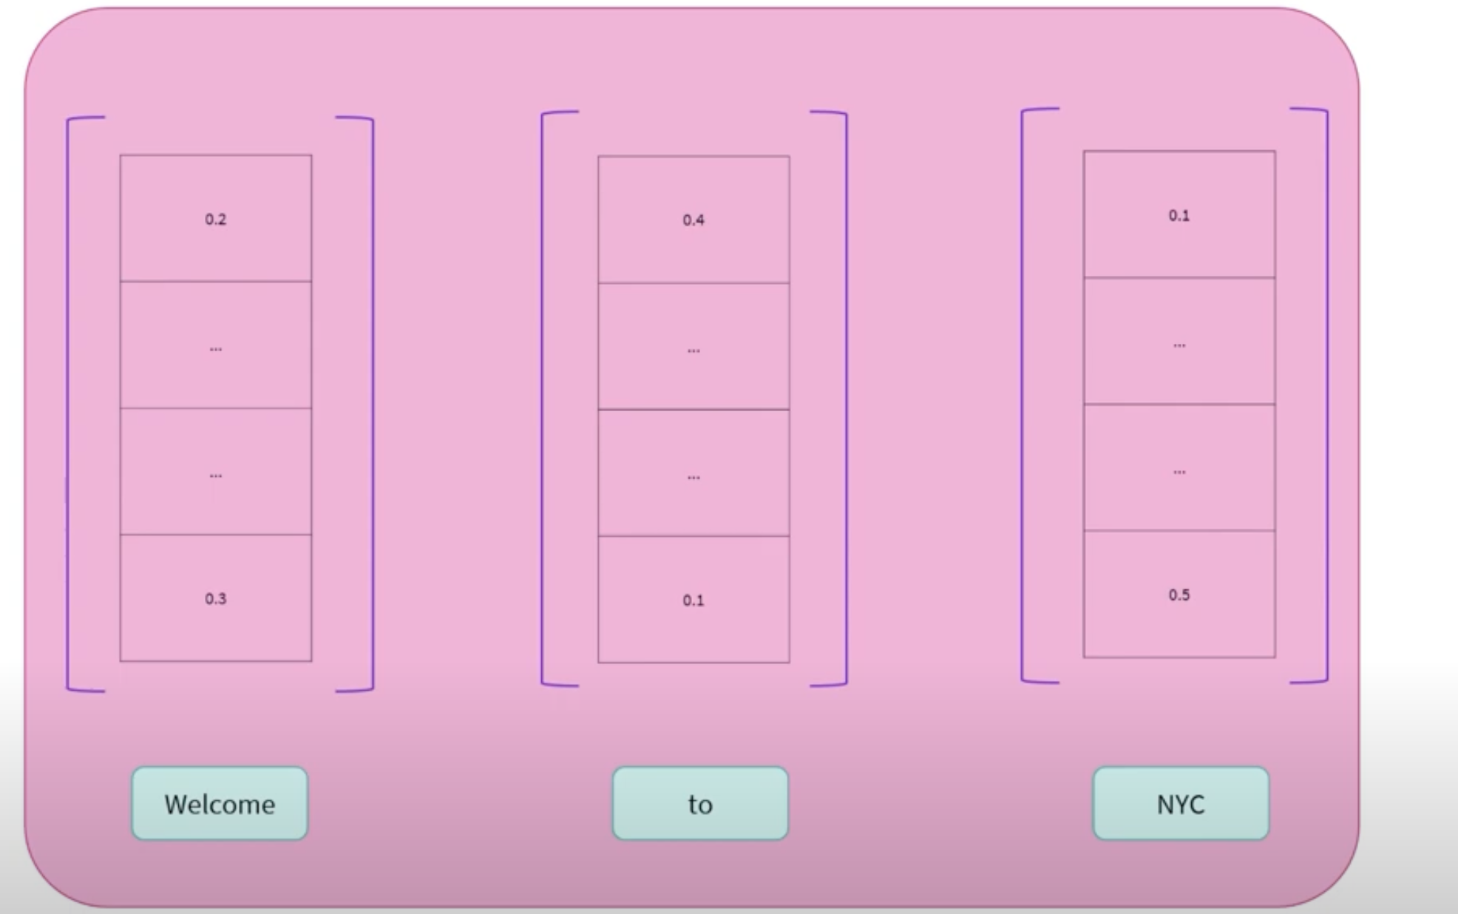
A Quick Recap
This is thanks to the attention mechanism
Slide credit: https://www.youtube.com/watch?v=MUqNwgPjJvQ&ab_channel=HuggingFace

Slide 7
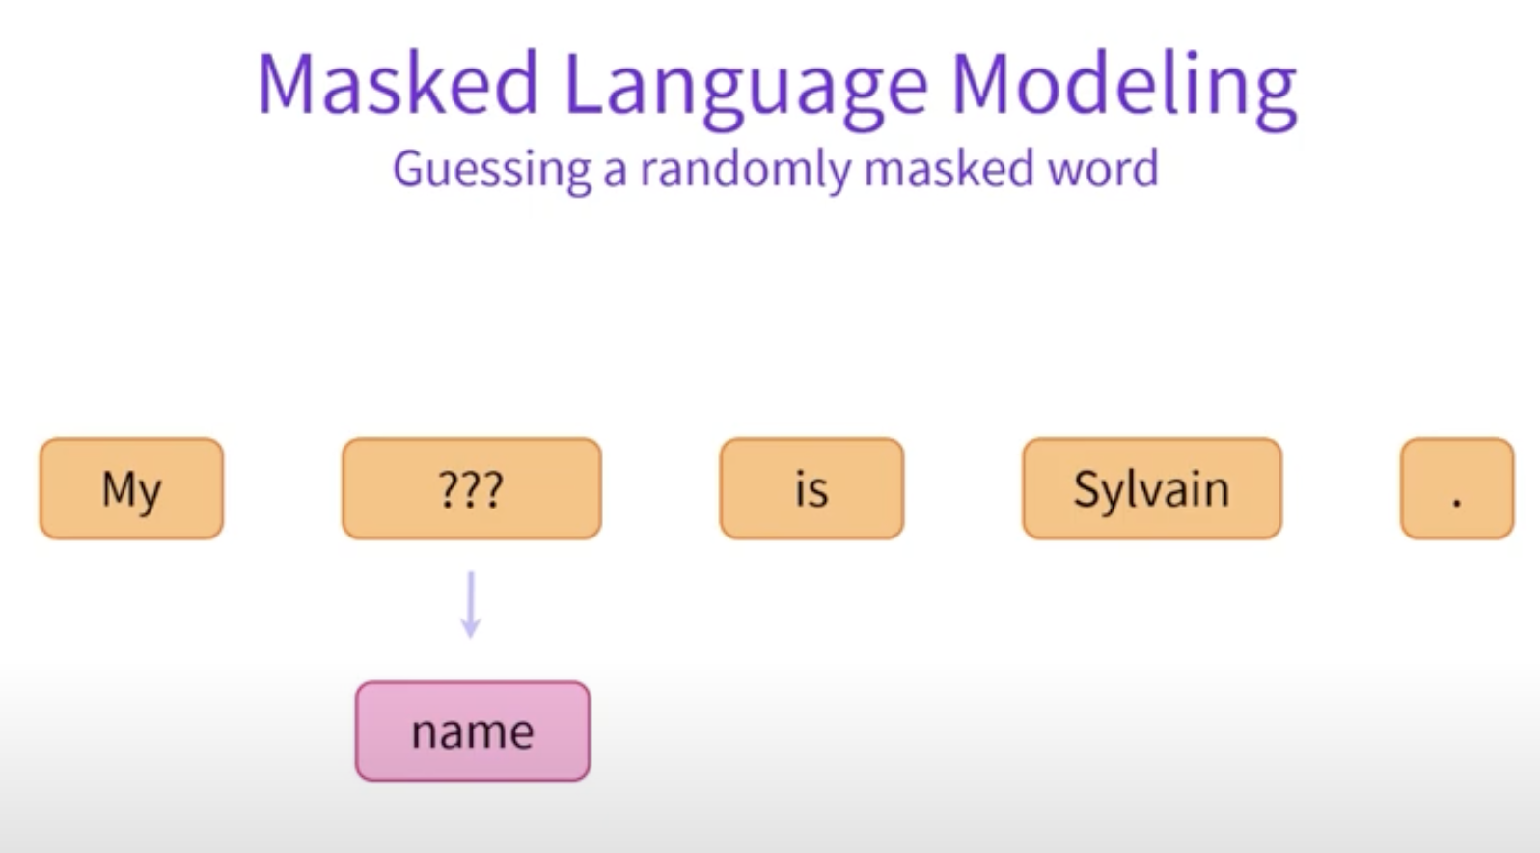
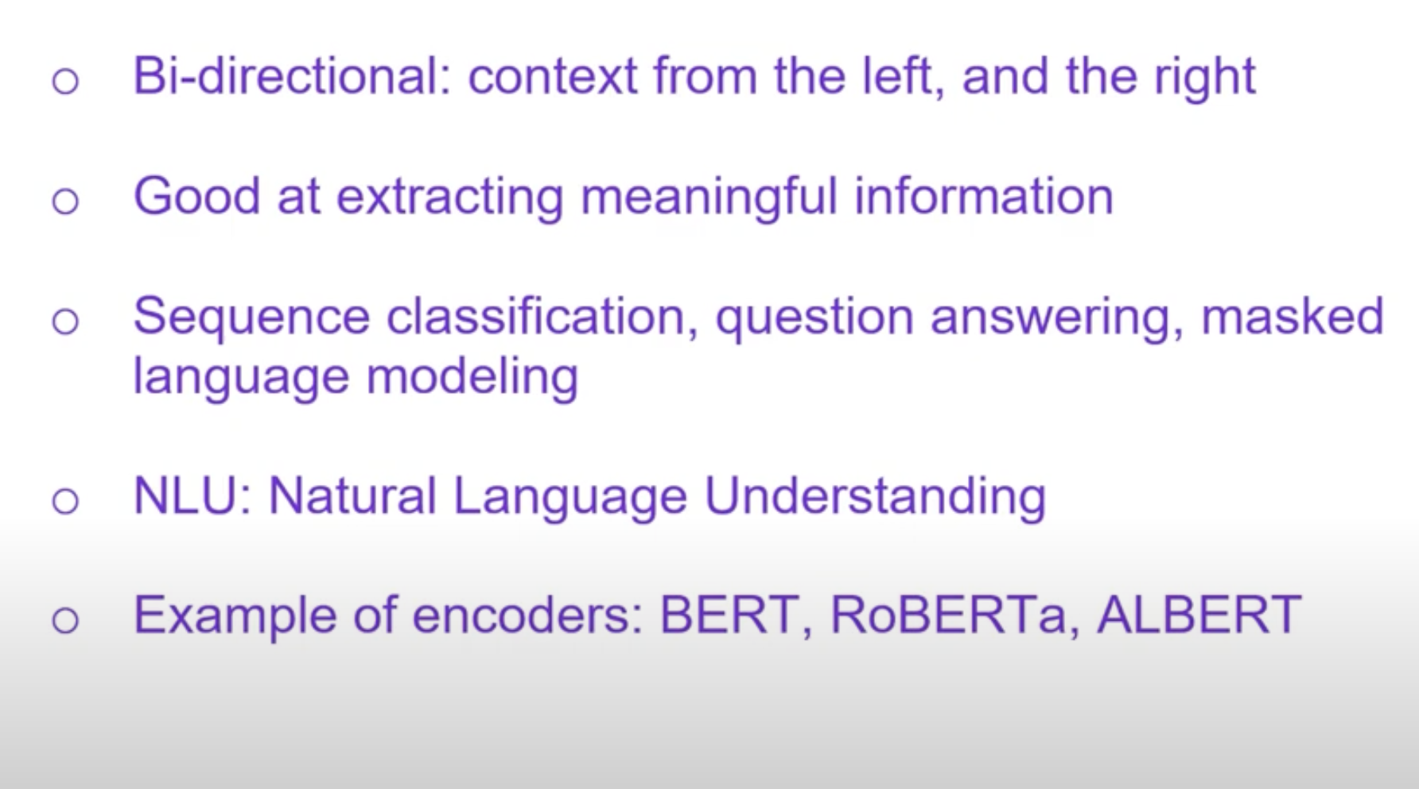
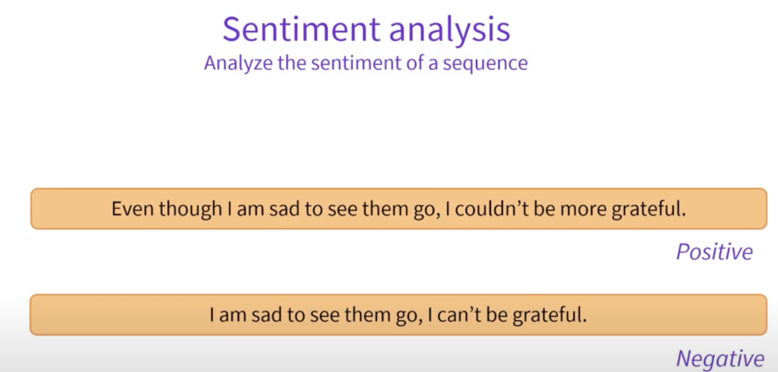
A Quick Recap
Encoders, with their bi-directional context, are good at guessing words in the middle of a sequence
Encoders are good at obtaining an understanding of sequences; and the relationship/interdependence between words.
Slide credit: https://www.youtube.com/watch?v=MUqNwgPjJvQ&ab_channel=HuggingFace

Slide 8
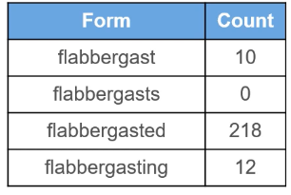
Bert’s Vocabulary
BERT is pre-trained Vocabulary fixed
Break down unknown words into subwords:
A subword exist for every character:
e m b e d d i n g
e m
b e d
d i n g
e m
# # b e d
# # d i n g
k r o x l d y p h i v c
k
R o
x
ld
Y p
hi
vc
BERT WordPiece Embeddings
Slide credit: http://mccormickml.com/2019/11/11/bert-research-ep-1-key-concepts-and-sources/

Slide 9
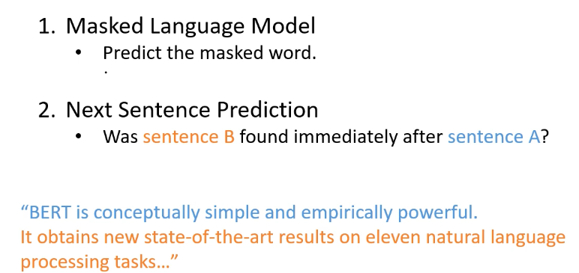
A Quick Recap
Slide credit: http://mccormickml.com/2019/11/11/bert-research-ep-1-key-concepts-and-sources/
Notes:
….
Ilk taskdan sonra ikinci görev için de eğitmişler. Çok iyi bi eğitim de olması geerkmiyor. Yani başarısı ile çok ilgilenmiyorsunuz. Önemli olan alt seviye layerların yeterince şeyi öğrenmesi dilin yapısı hakkında.

Slide 10
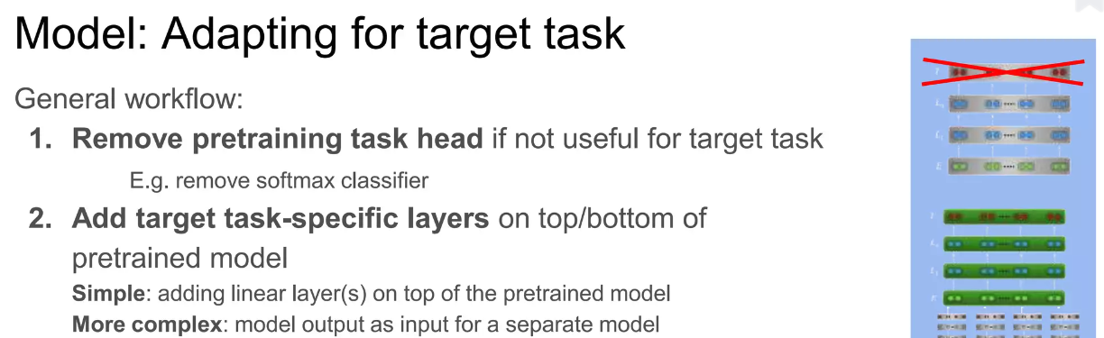
A Quick Recap - Transfer Learning
Slide credit:
Notes:
Last layerımızı siliyoruz.

Slide 11
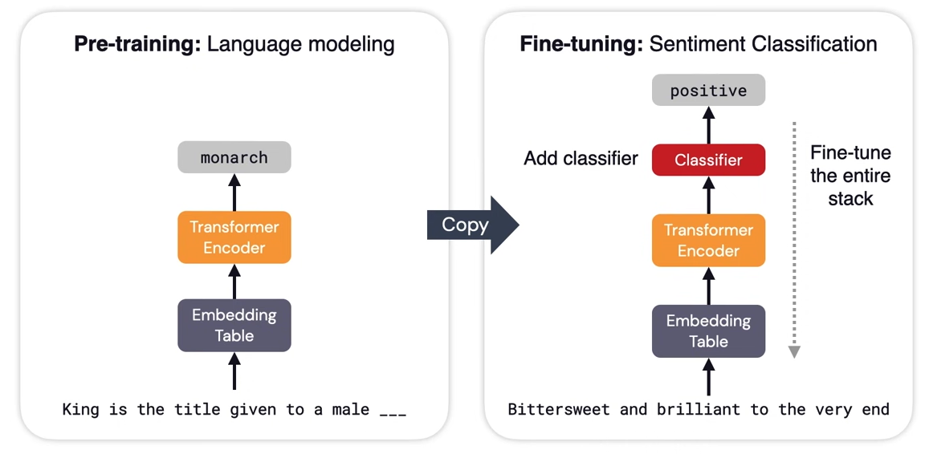
Transfer Learning
Slide credit:
Notes:
Non contextual continues represanatation – contextualize this embeddings
Bizim randomy initialize ettiğimiz ağırlıklarını, tek yapı classifierdaki ağırlıklar..
Bu fine tuning çok daha kısa ve hızlı olacaktır böylece.

Slide 12
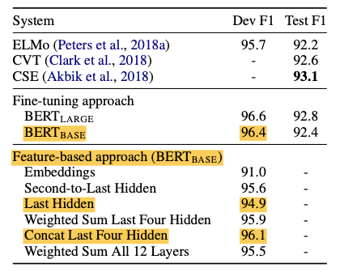
A Quick Recap
Freeze all layers, or not? -> https://towardsdatascience.com/what-exactly-happens-when-we-fine-tune-bert-f5dc32885d76
Slide credit:

Slide 13
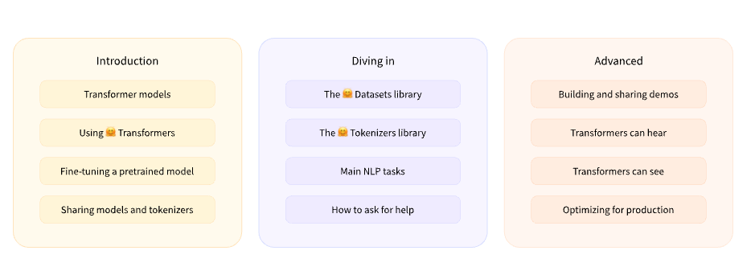
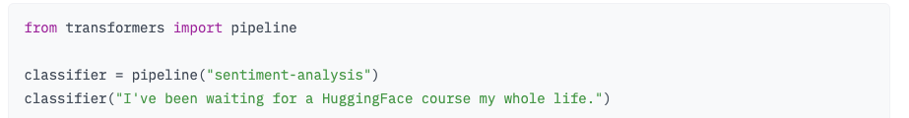
A Quick Recap - HuggingFace
Slide credit:
Notes:
Mesela spacy

Slide 14
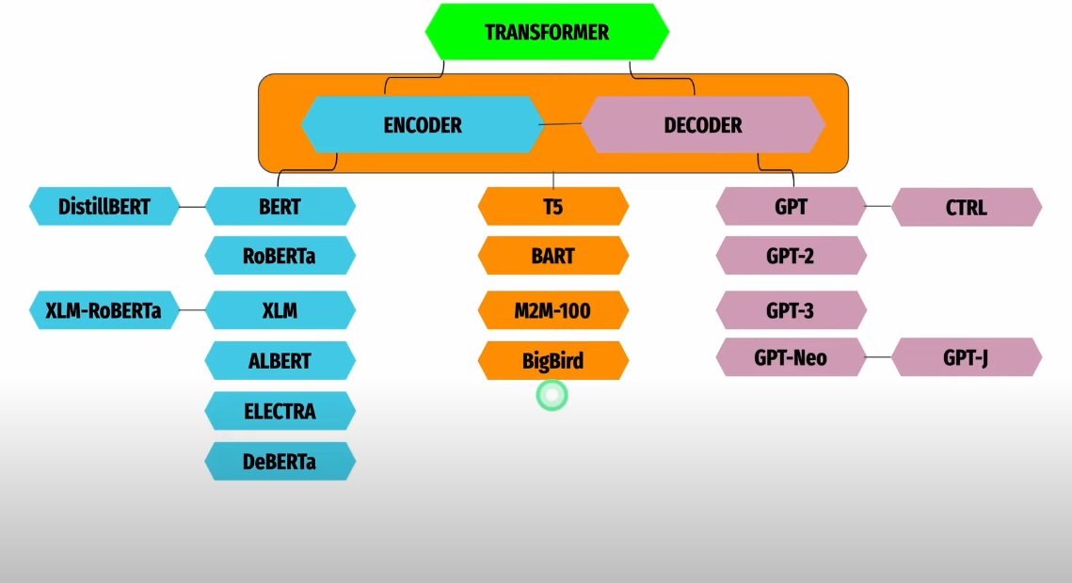
Transformers
Slide credit:

Slide 15
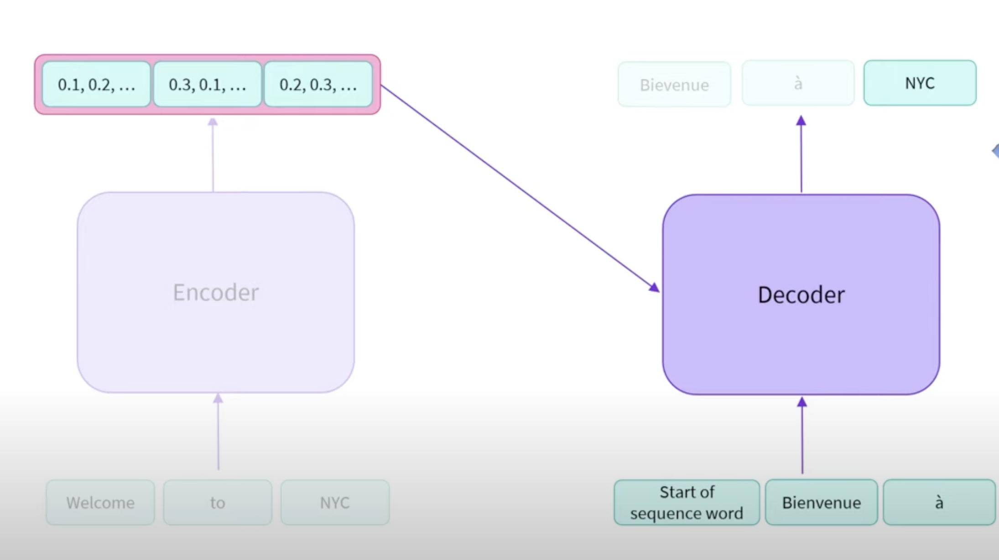
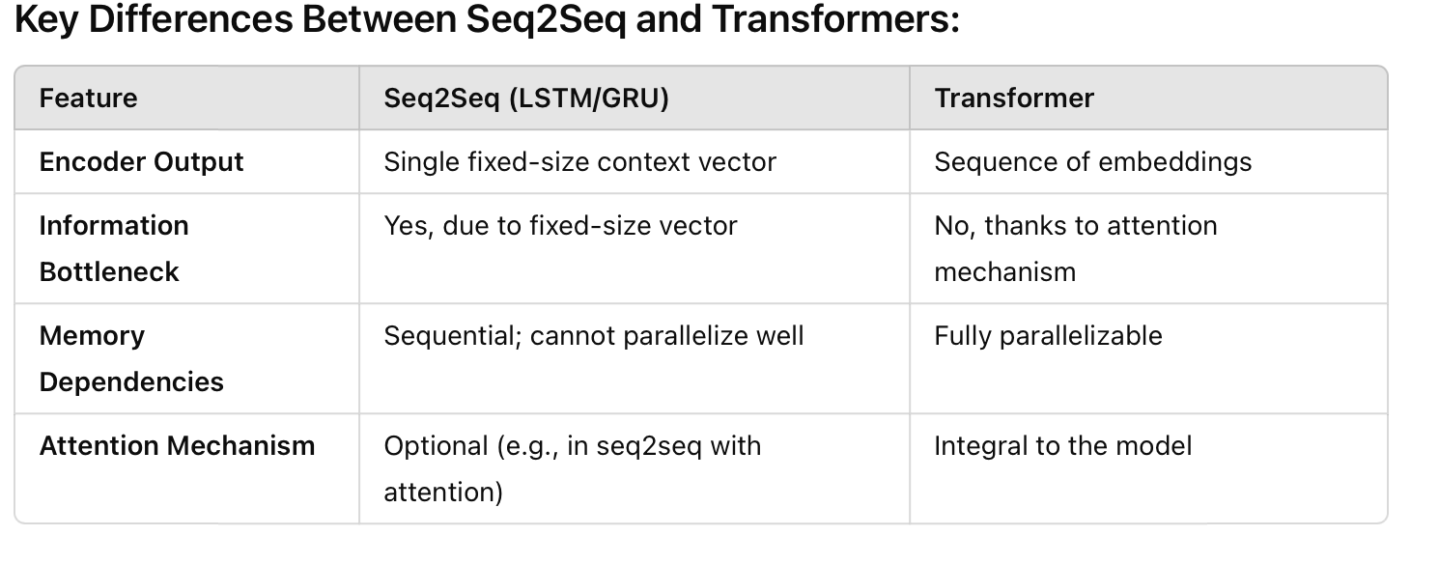
Encoder - Decoder
Slide credit:
Notes:
1. Seq2Seq Modellerinde Encoder Bir Darboğaz mı?
2. Transformer Modellerindeki Fark

Slide 16
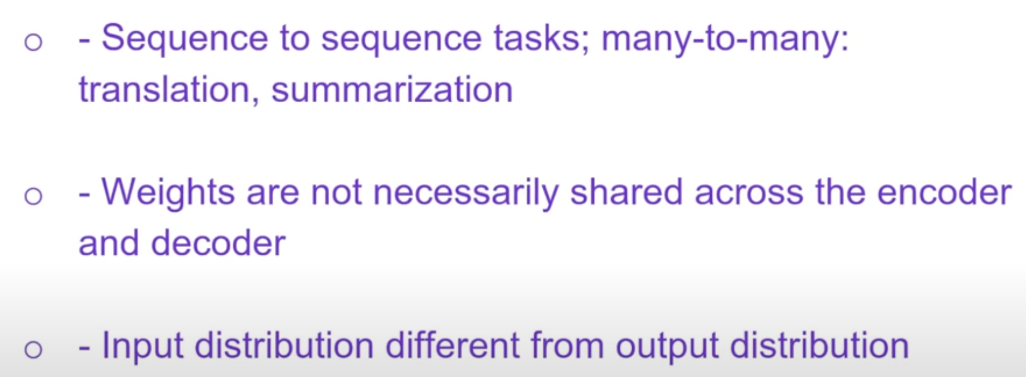
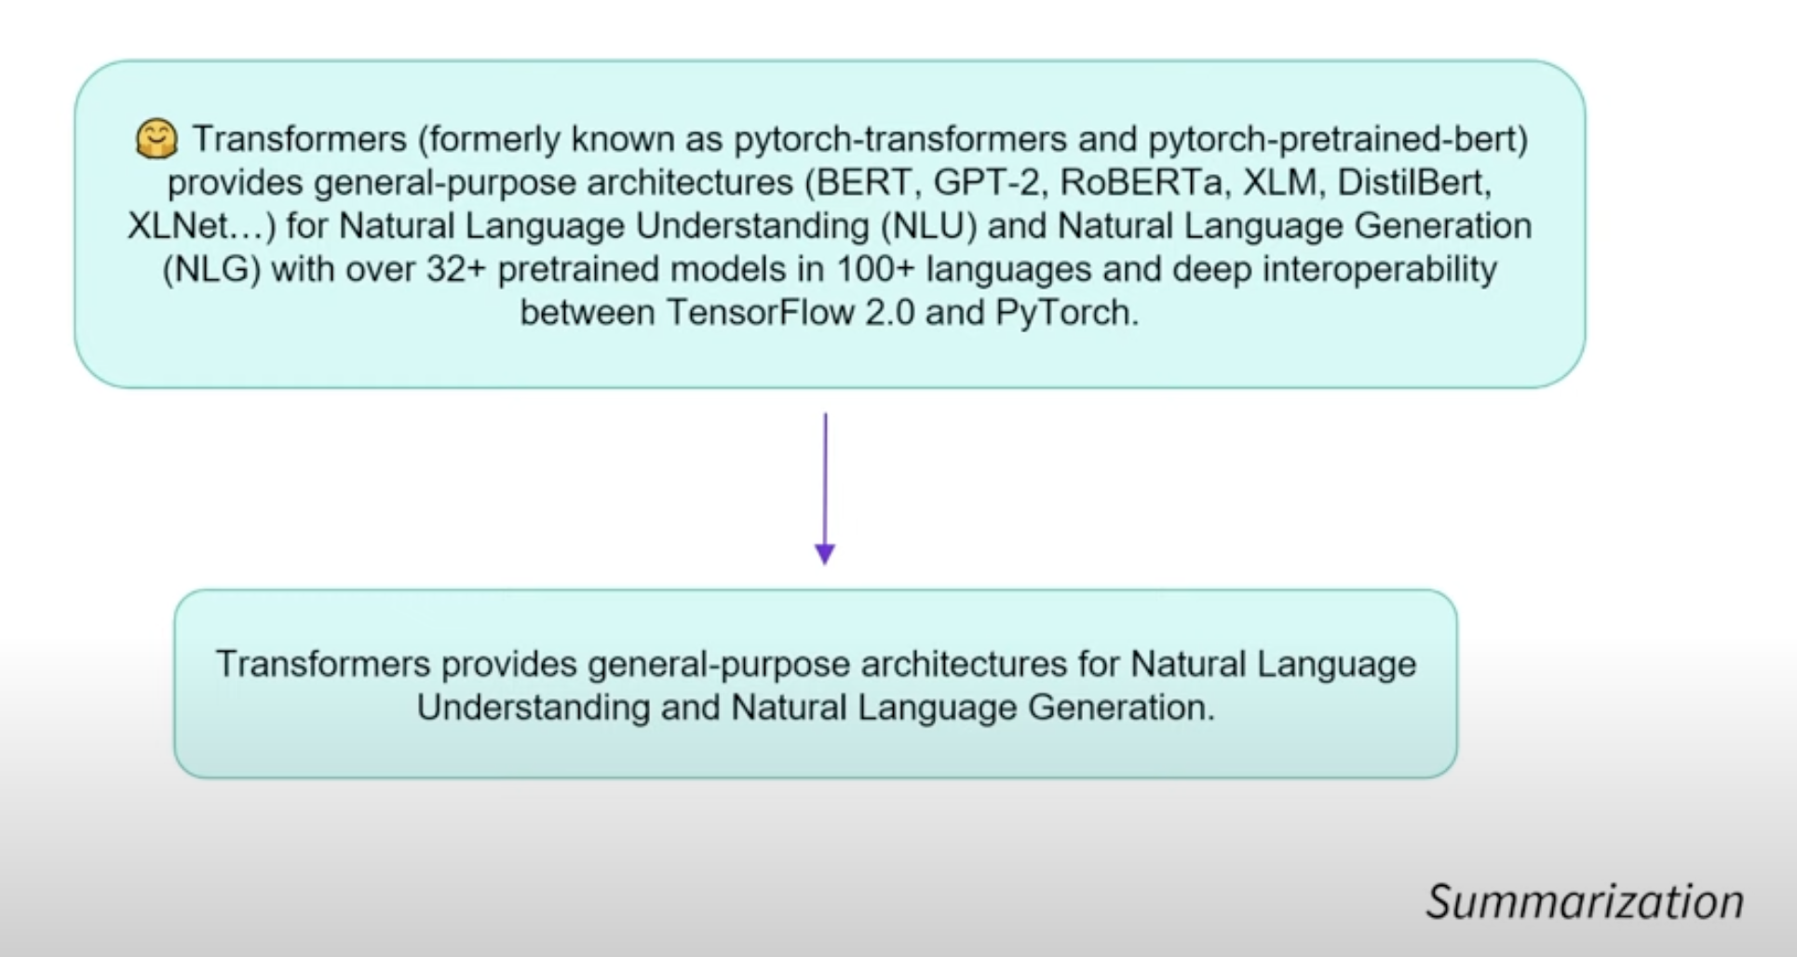
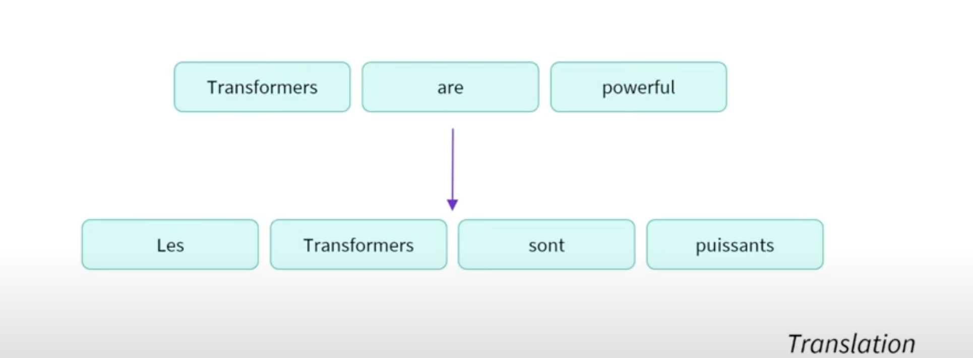
Encoder decoder
Slide credit:

Slide 17
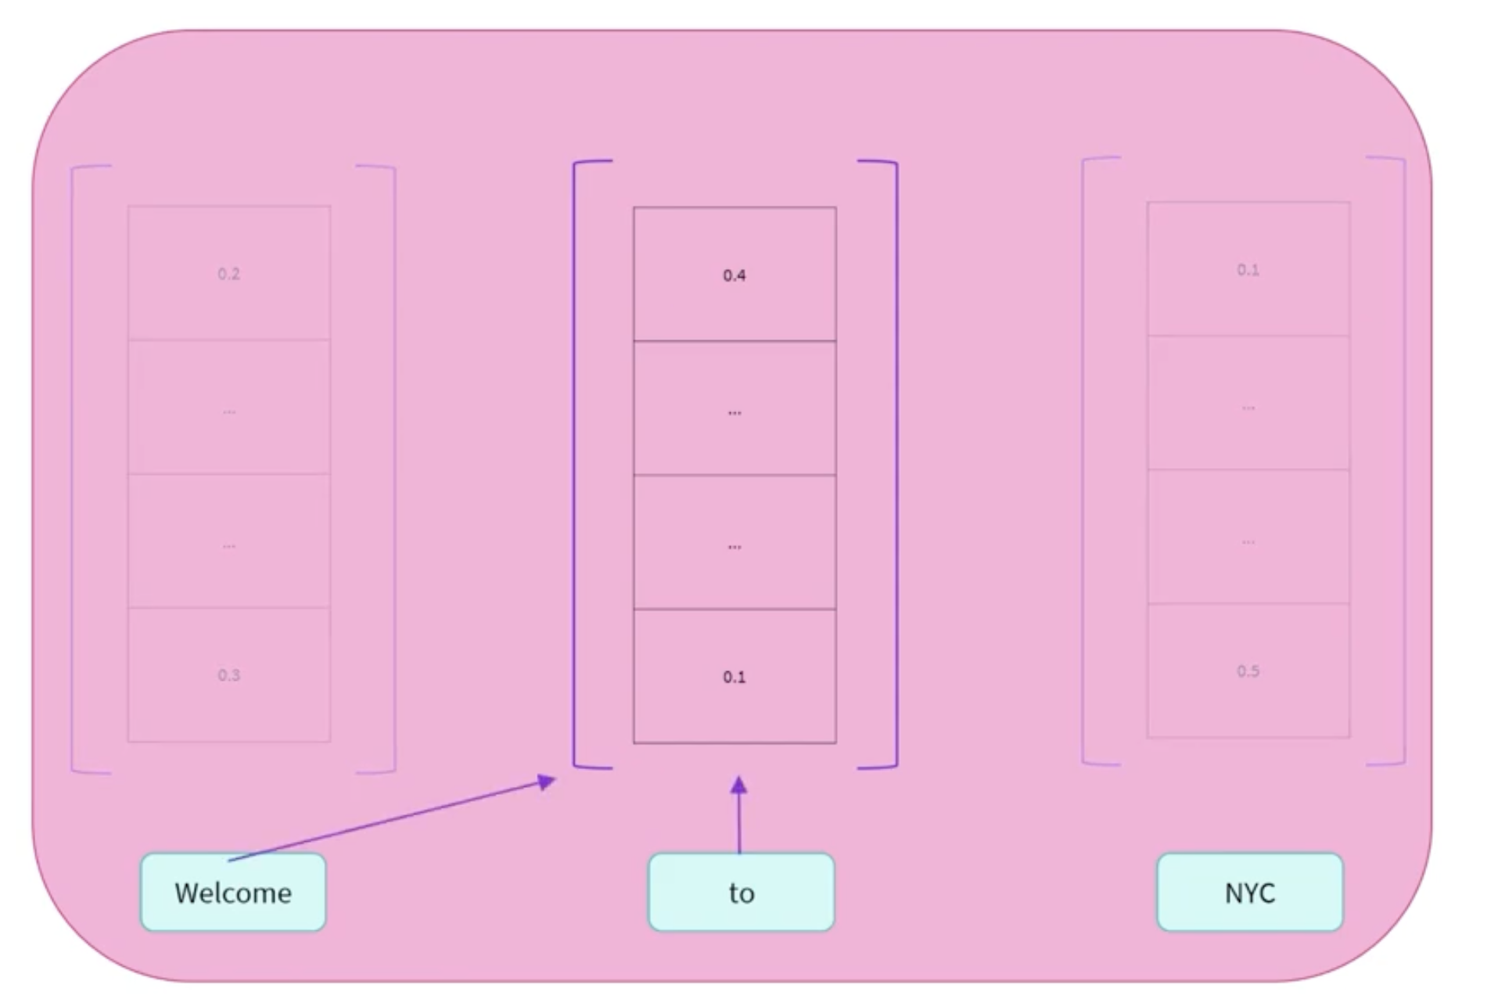
GPT
Slide credit:

Slide 18
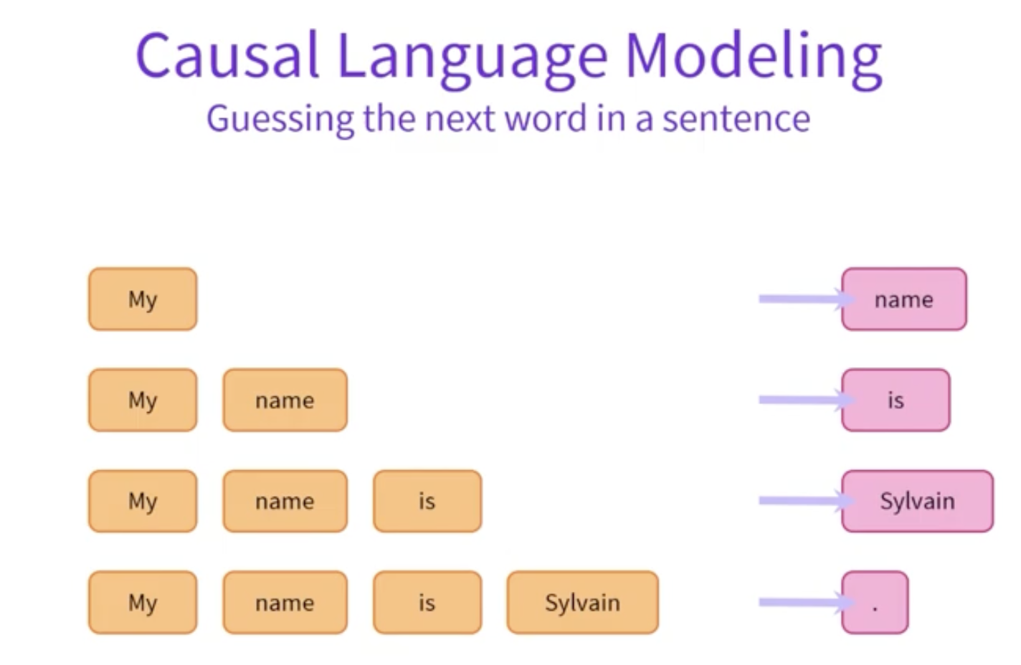
GPT
Slide credit:

Slide 19
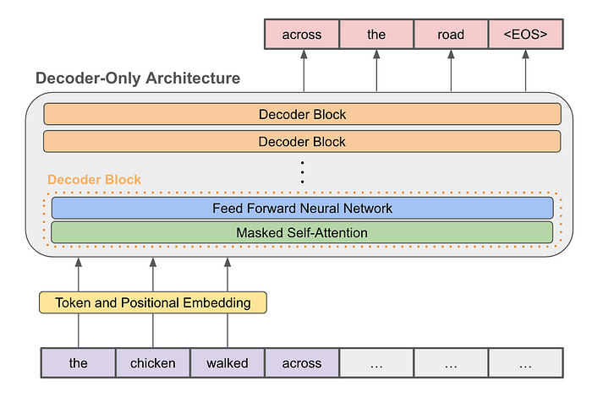
Decoder Side – GPT’s
A decoder-only architecture removes the following components from the transformer:
The entire encoder module
All encoder-decoder self-attention modules in the decoder
Slide credit:

Slide 20
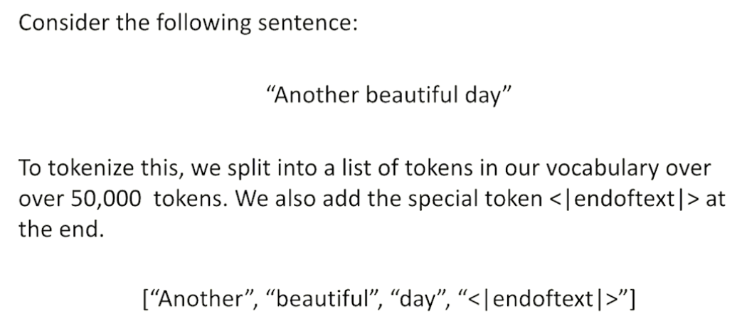
GPT - Tokenization
Slide credit:
Notes:
Auto regressive olduğunu söylemiştim. Yani endoftext I görene kadar üretmeye devame decektir.

Slide 21
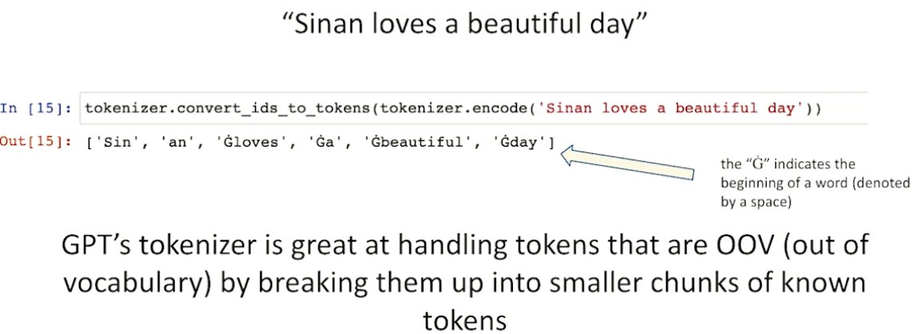
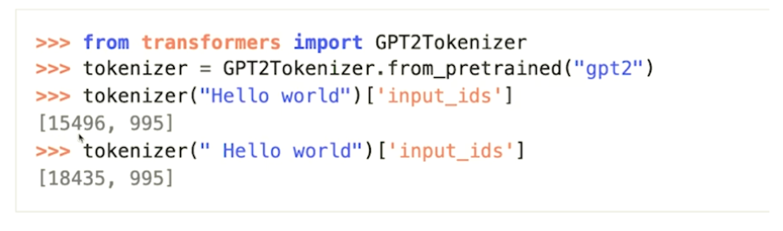
GPT
Slide credit:
Notes:
Boşluk koyarsak artık başka bir token bu yani başka bir anlama geliyor.

Slide 22
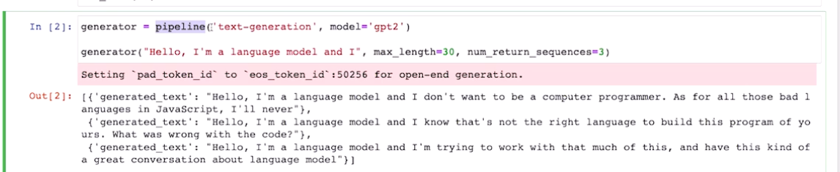
GPT
Slide credit:

Slide 23
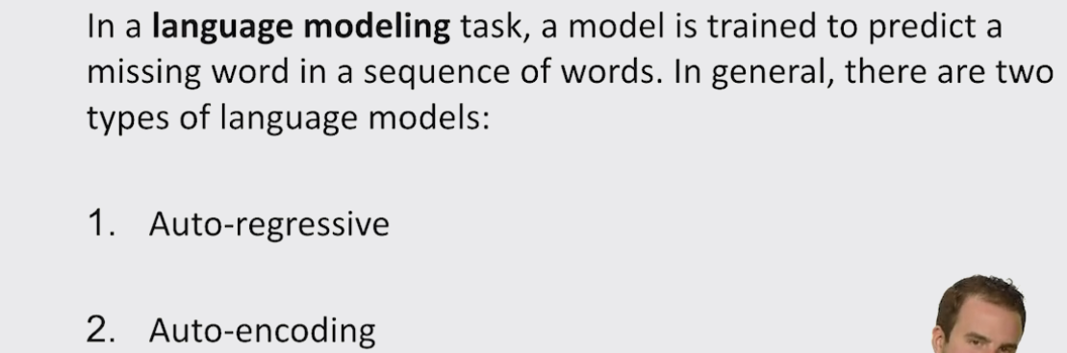
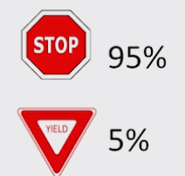
GPT
Slide credit:

Slide 24
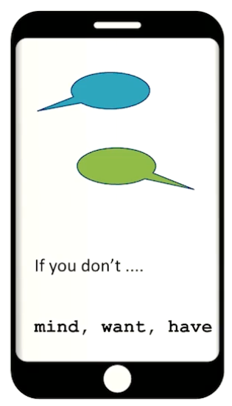
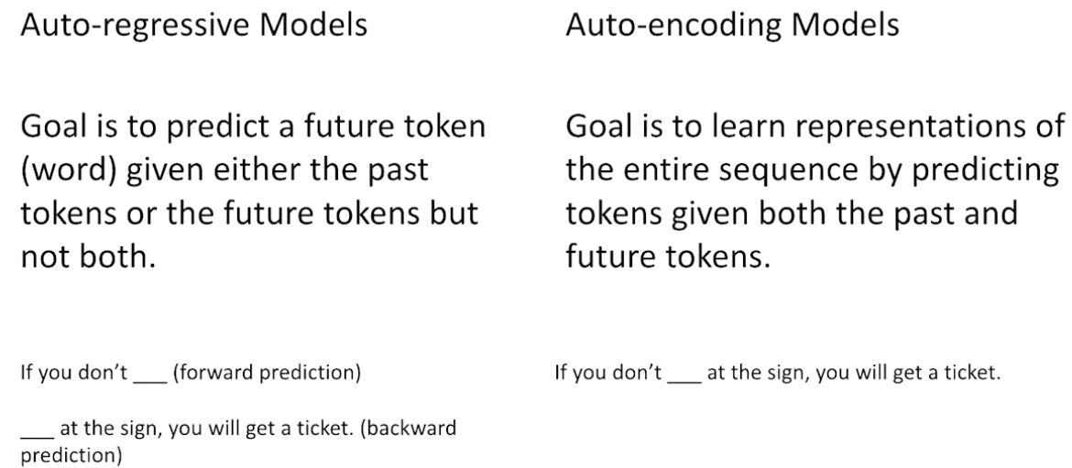
GPT
Slide credit:

Slide 25
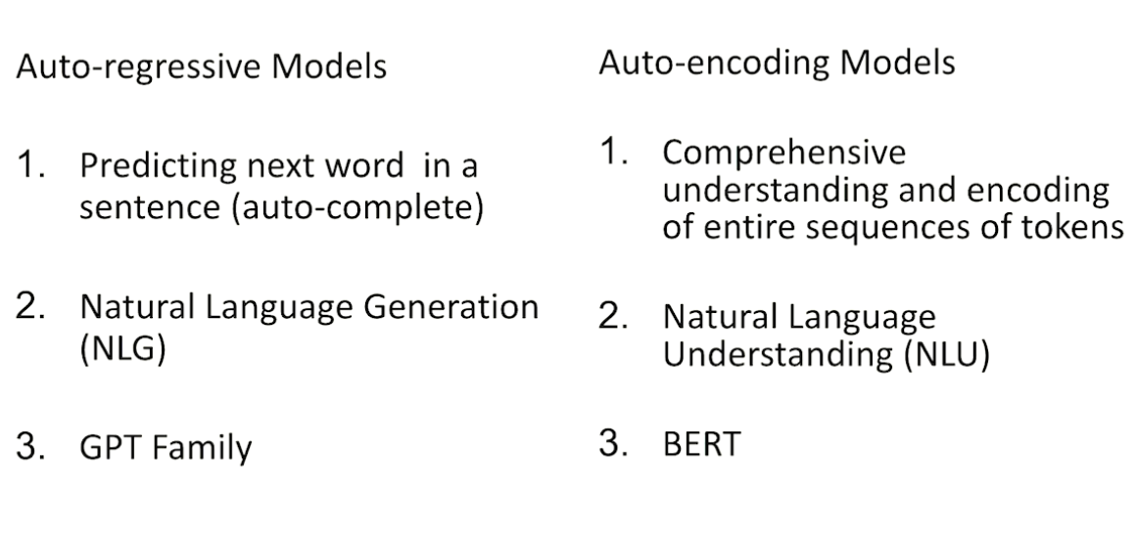
LM Use Cases
Slide credit:

Slide 26
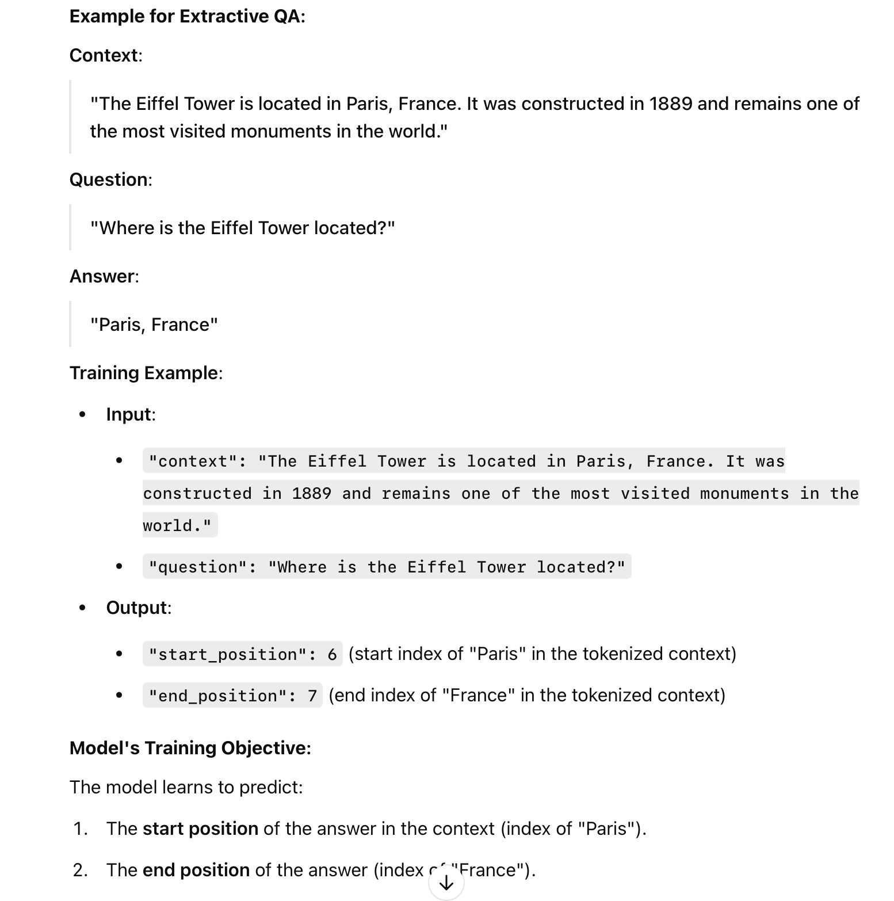
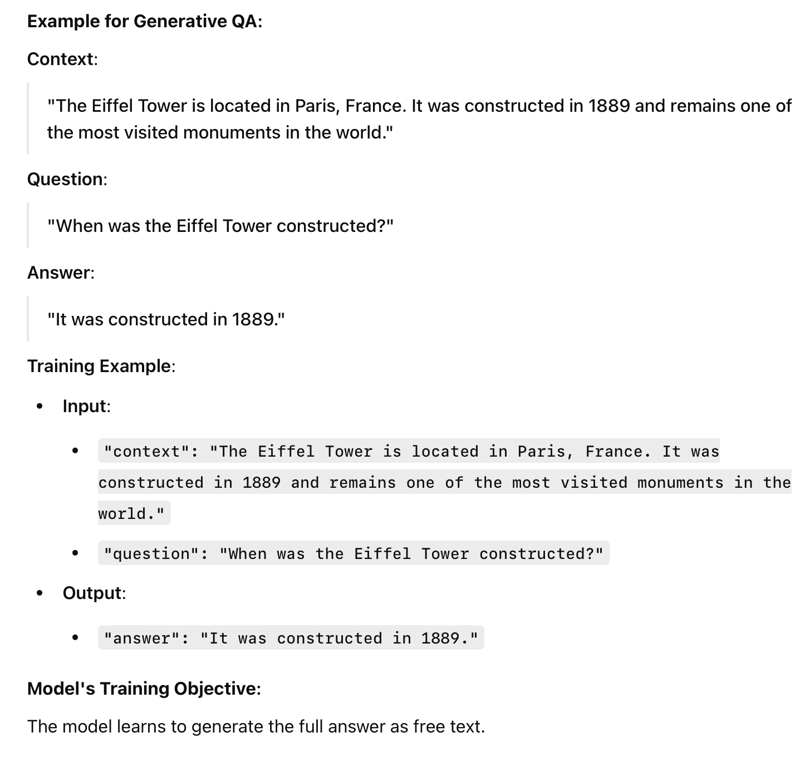
Question Answering (QA)
Extractive QA: The model identifies and extracts a span of text (direct answer) from the given context.Example: SQuAD dataset. Encoder models (e.g., BERT).Outputs start and end indices.
Generative QA: The model generates an answer in free text, often beyond what is explicitly written in the context.Example: Natural Questions dataset. Encoder-Decoder T5, BART
Slide credit:

Slide 27
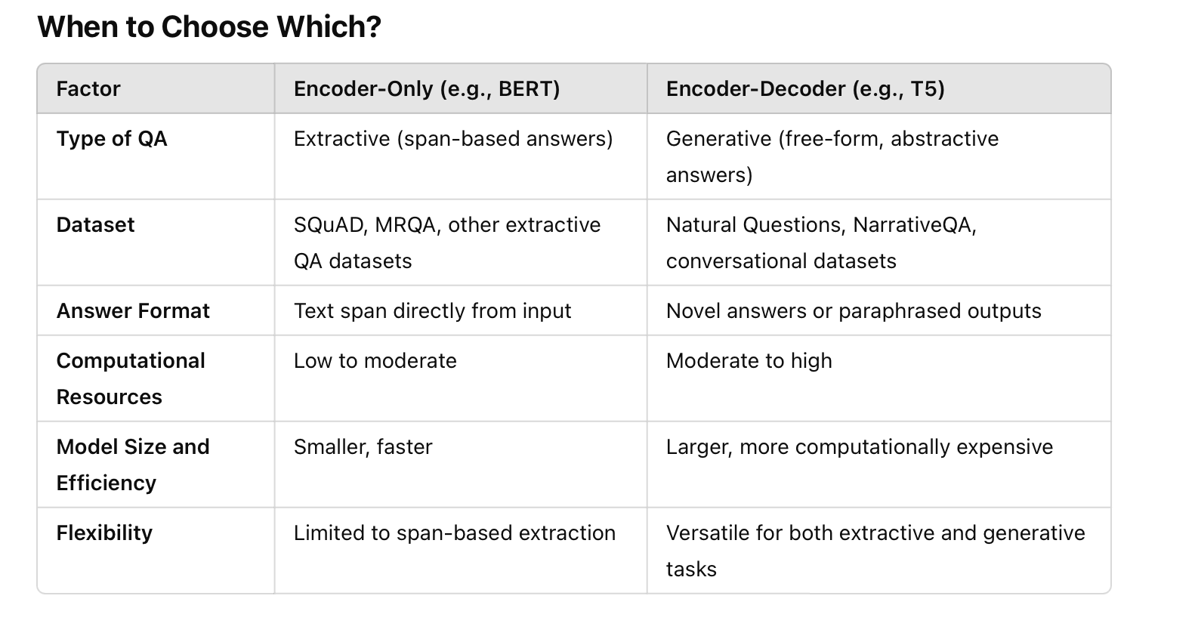
Question Answering (QA)
Slide credit:

Slide 28
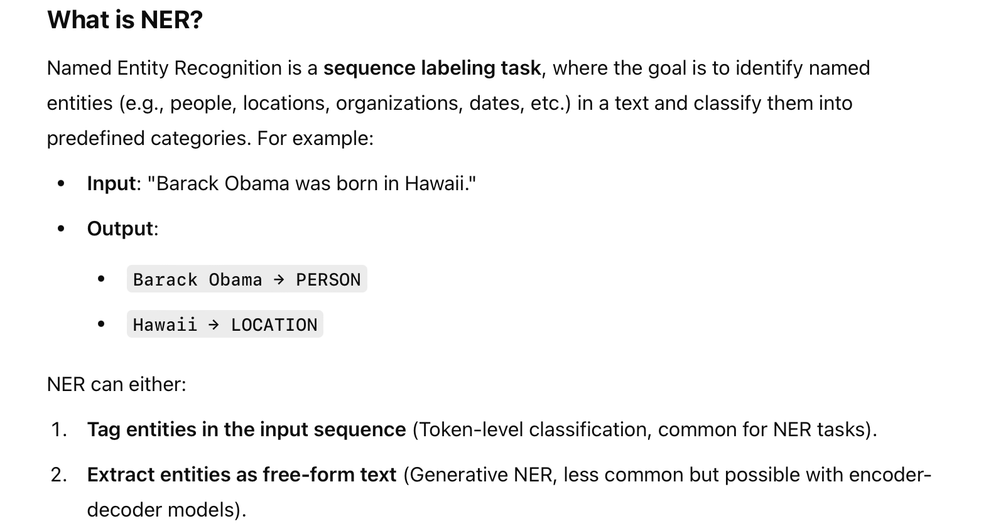
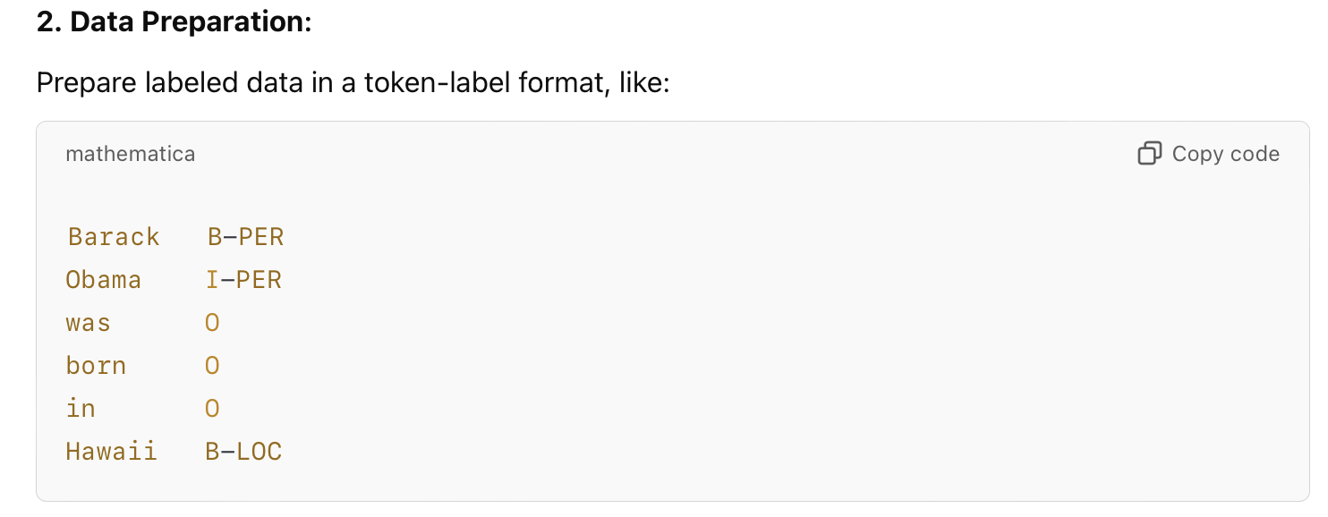
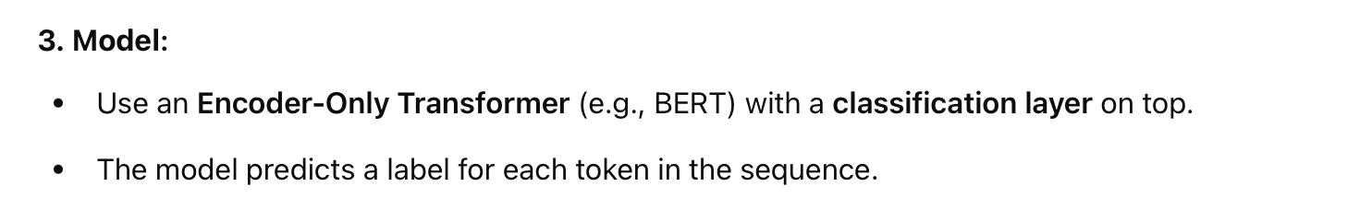
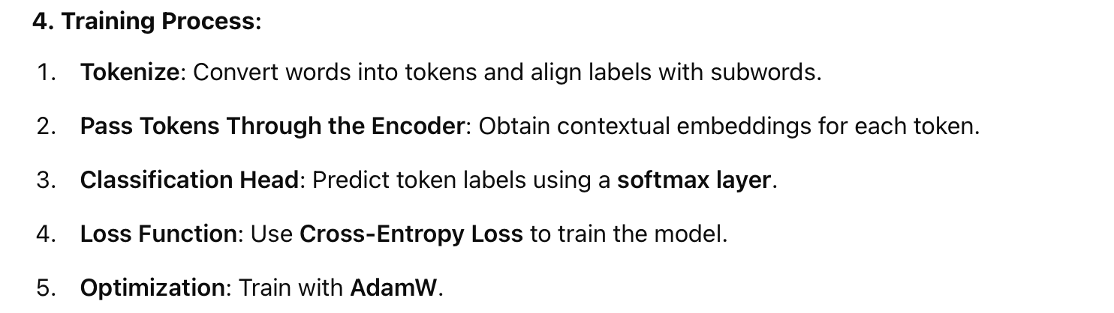
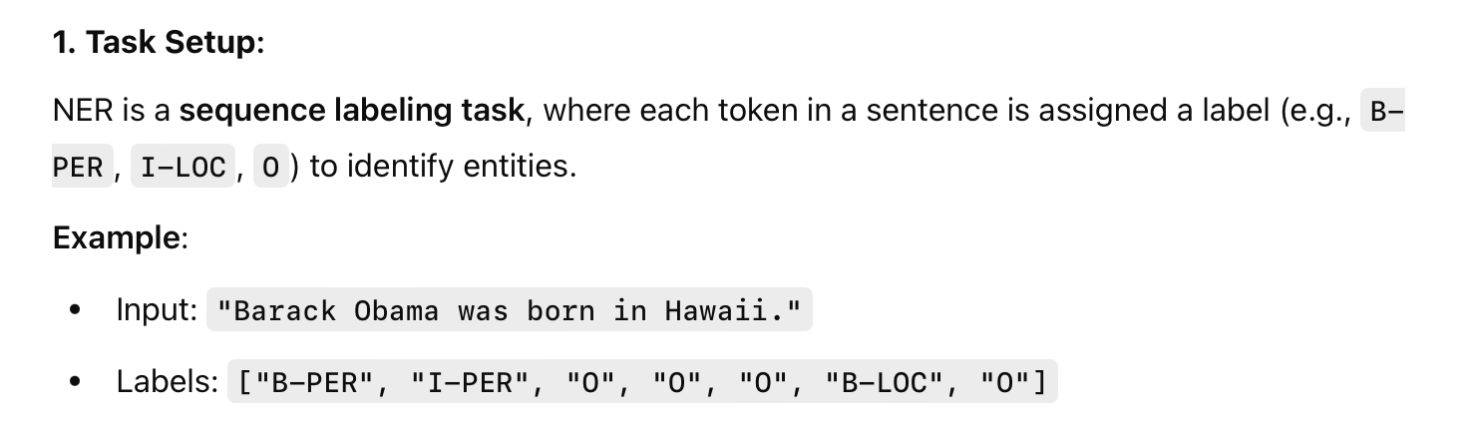
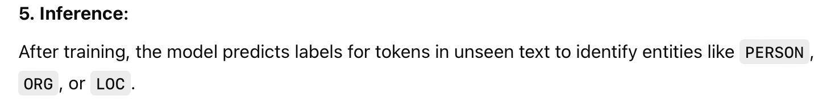
NER
Slide credit:

Slide 29
Coding Time
GPT : Next Word Prediction – FineTuning – Visual Studio Code
Finetuning BERT - https://colab.research.google.com/drive/1t-NJadXsPTDT6EWIR0PRzpn5o8oMHzp3?usp=sharing
Classifying Wikipedia Comments with BERT : https://colab.research.google.com/drive/1CfsGHuNWGGLg7ArPD_WE3sRuzFbDJav8
Clothing Reviews - Baselines and All-to-Text
https://colab.research.google.com/drive/1YRHK4HO8RktGzlYmGjBo056kzVD4_j9o#scrollTo=9cQNvaZ9bnyy
Slide credit:
Notes:
Anıl yoksa

Slide 30
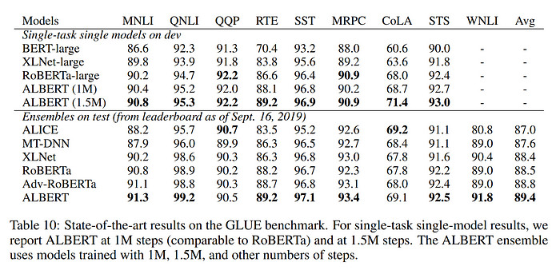
Speeding up BERT
Optimizing neural networks
Architecture improvements (change the architecture to a faster one, say, replace RNN to a Transformer or a CNN; use layers that require fewer computations and so on) or more clever optimization (learning rate and policy, number of warmup steps, larger batch size, etc).
Slide credit:

Slide 31
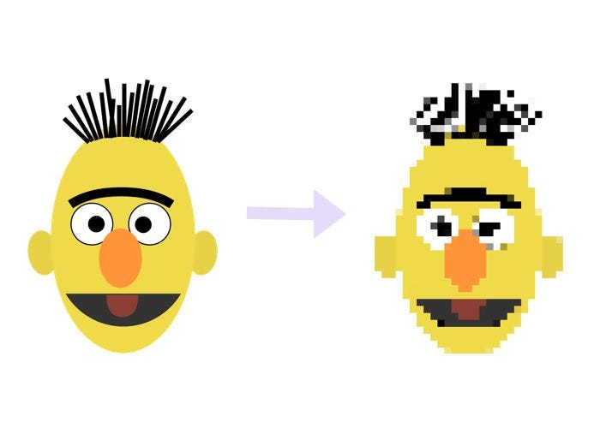
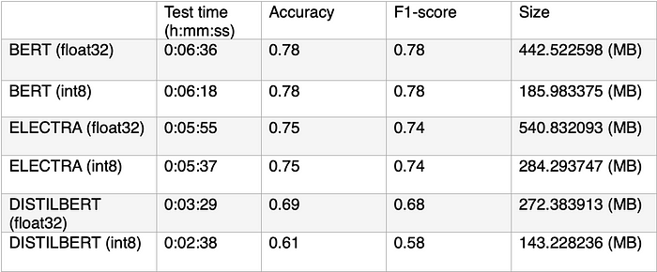
Speeding up BERT
Model compression (usually done using quantization and/or pruning, reducing the total amount of computations keeping the architecture unchanged. OK, mostly unchanged).
Quantization and pruning
Quantization decreases the numerical precision of a model’s weights.
Typically models trained using FP32 (32-bit floating point), then they can be quantized into FP16 (16-bit floating point), INT8 (8-bit integer) or even more to INT4 or INT1, so reducing the model size 2x, 4x, 8x or 32x respectively. This is called post-training quantization.
https://medium.com/kariyertech/lightweight-ai-38b9c0ab05c3
Slide credit:
Notes:
Pruning removes some (not- or less-important) weights (or sometimes neurons) from the model, producing sparse weight matrices (or smaller layers). There is also research on removing entire matrices corresponding to attention heads of a transformer.

Slide 32
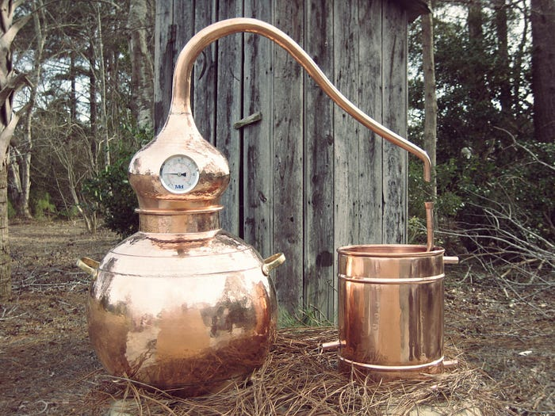
Speeding up BERT
Model distillation (train a smaller model that will replicate the behavior of the original model)
Another interesting model compression method is distillation — a technique that transfers the knowledge of a large “teacher” network to a smaller “student” network. The “student” network is trained to mimic the behaviors of the “teacher” network.
Slide credit:

Slide 33
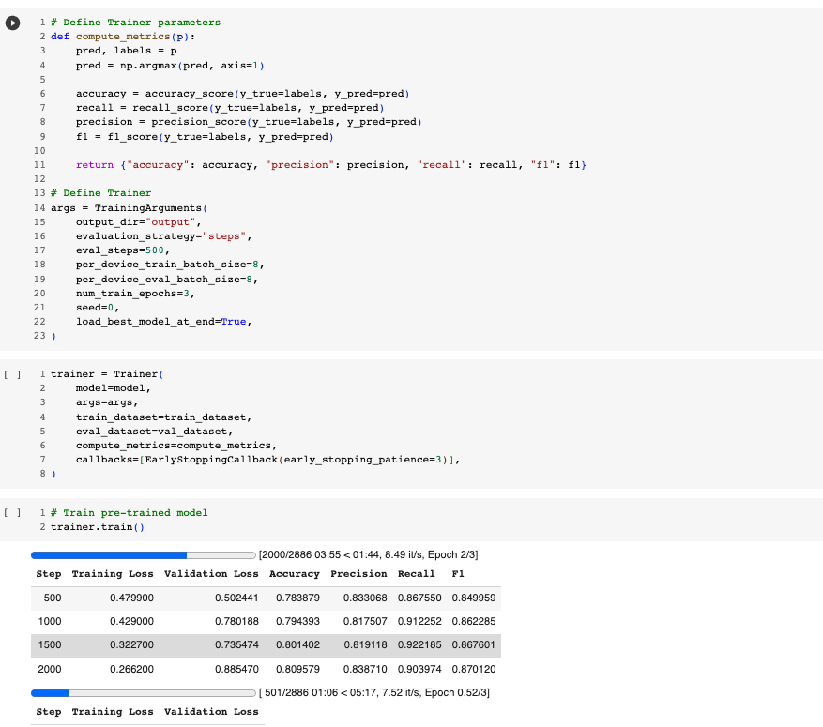
A Quick Recap
Slide credit:

Slide 34
Next Week
Next Lesson willl be at May 29
NER, QA, Summarization
BERT + Categorical Features
End-to-end Project Development
Slide credit:

Slide 35
A Quick Recap
Elamanın videodan biraz devam
Tokenized konusu ## lar
Classification head kısmı - bütün datayı eğitiyoruz. Earl data freeze işi , başka katman ekleme vs
Fine tune Auto fine tuning
Encoderlar vardı decoderı atıyoduk
Berti eğitmek için 2 fake task! -- ERT Research - Ep. 4 - Inner Workings I
Multilingual bert ler de varişinize yarayabilr
Attentionlara girelim mi bakalım
Başka hangi modeller var? Nasıl kullanıcaz?
Biraz GPt den bahsetmece sonra diğer bert modelleri
Sonra kod
Question & Answering Bert
Semantic arama
Haftaya
BERT + Categorical Features - Ep. 1 - Everything-to-Text – haftaya olabilir
Diğer taskler içni örnekler. Summary + NER – vs.
Production için öneriler + hızlandırma + apiye dönüştürme
Slide credit:

